Slide 1
Displaying Categorical Data
Miss L
Year 11 Essentials

Slide 2
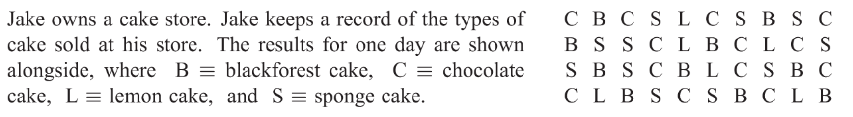
24
7
30
Displaying Categorical Data
Date
EQ – How can we display categorical data?
Is the above scenario categorical data or numerical data?
It’s categorical because the data is divided into categories: different kinds of cakes.
How can we display this data?

Slide 3
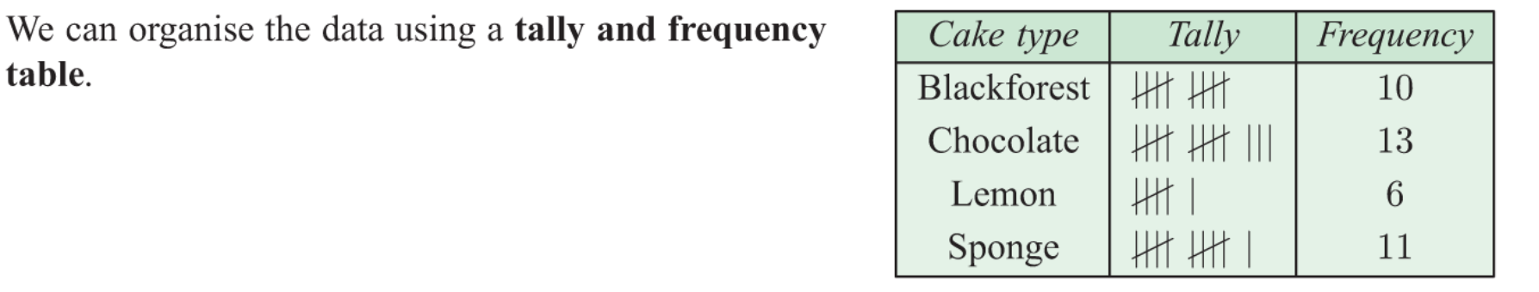
24
7
30
Displaying Categorical Data
Date
EQ – How can we display categorical data?

Slide 4
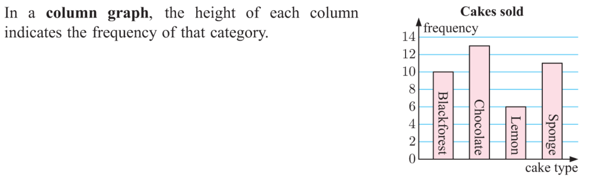
24
7
30
Displaying Categorical Data
Date
EQ – How can we display categorical data?

Slide 5
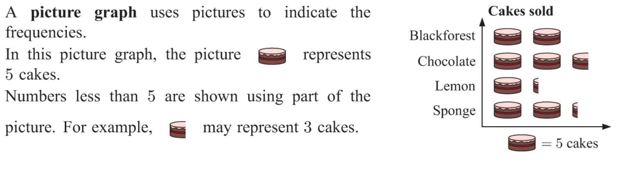
24
7
30
Displaying Categorical Data
Date
EQ – How can we display categorical data?

Slide 6
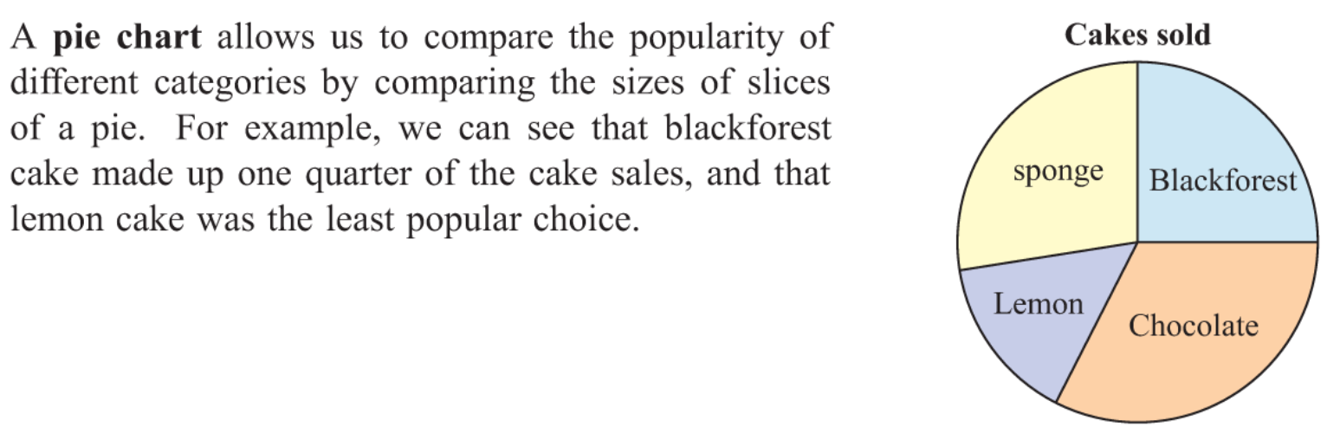
24
7
30
Displaying Categorical Data
Date
EQ – How can we display categorical data?

Slide 7


Slide 8
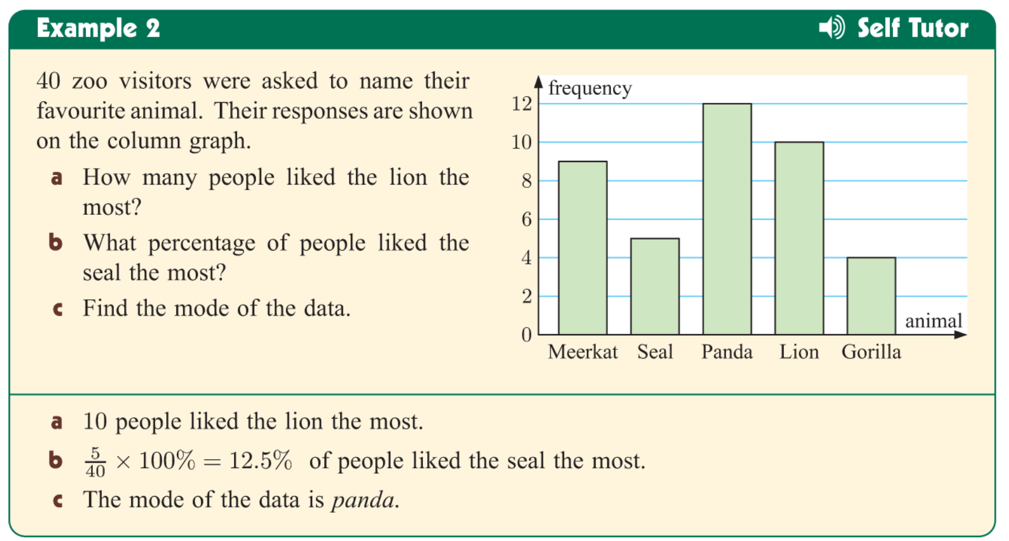

Slide 9
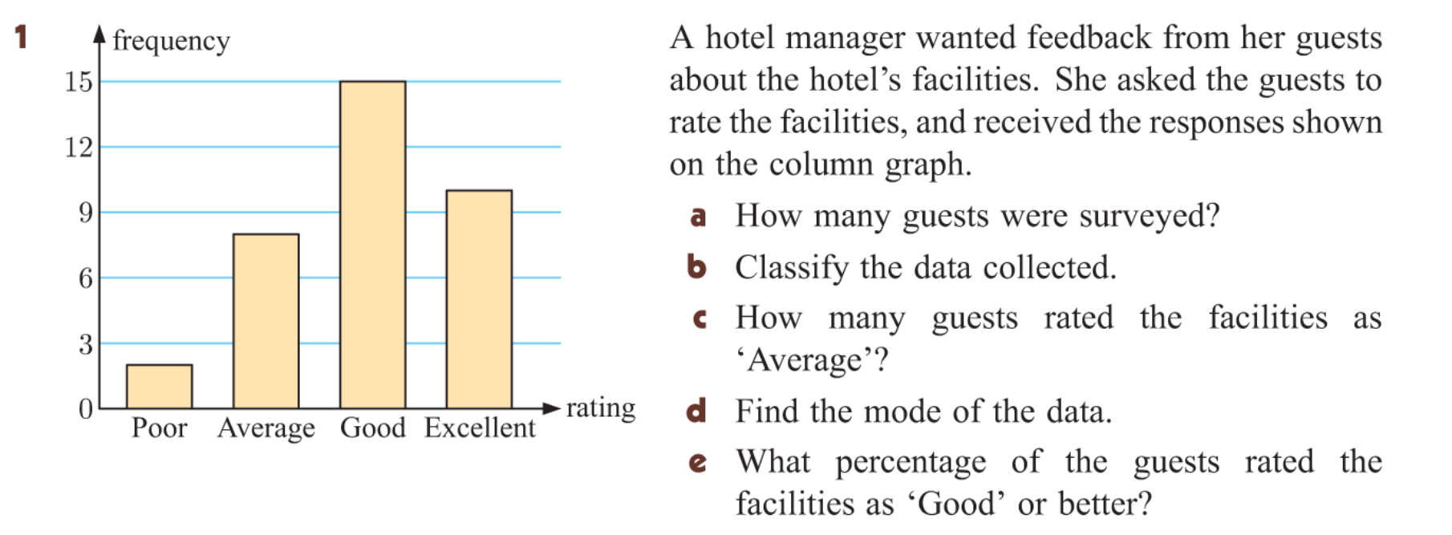
Task
Complete the worksheet

